Slide 1
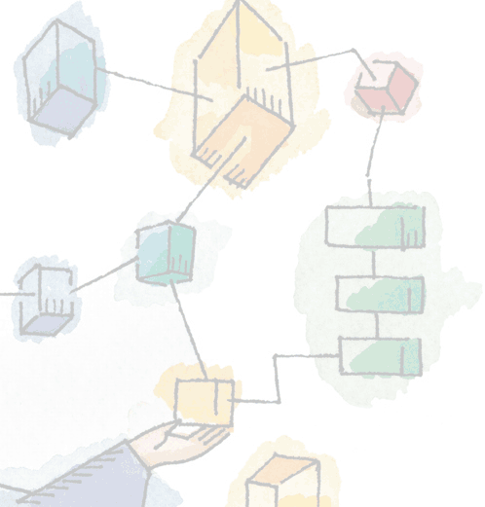
Need of synchronization in concurrent execution
This Presentation Covers:
Introduction to Normalization
Key terms used in normalization
Introduction to First Normal Form(1NF)
Introduction to Second Normal Form(2NF)
Introduction to Third Normal Form(3NF)
Introduction to Forth Normal Form(4NF)
Research Work Done
Presented By:
Rahul Singhai (PhD , M.Phil, MCA)
Assistant Professor
IIPS, DAVV , Indore

Slide 2
What is concurrency??
Concurrency means concurrent execution of processes.
Types of concurrent processes:
Independent Process
Cooperating Process

Slide 3
Producer/Consumer
Problem
General Situation:
  One or more producers are generating data and placing these in a buffer
  A single consumer is taking items out of the buffer one at time
  Only one producer or consumer may access the buffer at any one time
The Problem:
  Ensure that the Producer can’t add data into full buffer and consumer can’t remove data from empty buffer
Producer/Consumer Animation
Notes:
The general statement is this:
There are one or more producers generating some type of data (records, characters) and placing these in a buffer.
There is a single consumer that is taking items out of the buffer one at a time.
The system is to be constrained to prevent the overlap of buffer operations. That is, only one agent (producer or consumer) may access the buffer at any one time.
The problem is to make sure that the producer won’t try to add data into the buffer if it’s full and that the consumer won’t try to remove data from an empty buffer.
We will look at a number of solutions to this problem to illustrate both the power and the pitfalls of semaphores.

Slide 4
Producer/Consumer
Problem
The shared buffer is implemented as a circular array with two logical pointers: in and out. The variable in points to the next free position in the buffer and out points to the first full position in the buffer.
The buffer is empty when In=out;
The buffer is full when in+1 mod n = out;
Producer/Consumer Animation
Notes:
The general statement is this:
There are one or more producers generating some type of data (records, characters) and placing these in a buffer.
There is a single consumer that is taking items out of the buffer one at a time.
The system is to be constrained to prevent the overlap of buffer operations. That is, only one agent (producer or consumer) may access the buffer at any one time.
The problem is to make sure that the producer won’t try to add data into the buffer if it’s full and that the consumer won’t try to remove data from an empty buffer.
We will look at a number of solutions to this problem to illustrate both the power and the pitfalls of semaphores.

Slide 5
code
Assume an infinite buffer b with a linear array of elements
Producer | Consumer
Repeat produce an item in nextp while counter = n do nothing; buffer[in] := nextp; in:= in+1 mod n; counter:= counter+1; until false; | Repeat while counter =0 do nothing; nextc=buffer[out]; out:= out+1 mod n; counter=counter-1; Cosume the item in nextc Until false;

Slide 6
Producer/Consumer
Problem
Although both the producer and consumer processes are correct separately, they may not function correctly when executed concurrently
To see how the value of counter may be incorrect, first we see how the statement counter=counter +1; and counter=counter -1 are implemented in machine language.
Producer | Consumer
Register₁ := counter; Register_{1 :=} Register₁ +1; Counter := Register_{1;} | Register₂ := counter; Register_{2 :=} Register₂ -1; Counter := Register_{2;}

Slide 7
Producer/Consumer
Problem
Now consider the following inter leaving pattern:
T₀: Producer execute Register₁ := counter; {Register₁=5} T₁: Producer execute Register₁ := Register₁ +1; {Register₁=6} T₂: Consumer execute Register₂ := counter;; {Register₂=5} T₃: Consumer execute Register₂ := Register₁ -1; {Register₂=4} T₄: Producer execute counter := Register₁ ; {Counter=6} T₅: Consumer execute counter := Register₂ ; {Counter=4}
Notice that we have arrived at the incorrect state “counter=4” recording that there are four full buffers. If we reserved the order of the statements at T4 and T5, we would arrive at the incorrect state “counter=6” though infact there are five full buffers.

Slide 8
Producer/Consumer
Problem
A situation like this, where several processes access and manipulate the same data concurrently and the outcome of the execution depends on the particular order in which the access takes place, is called a race condition.
To guard against the race condition above, we need to ensure that only one process at a time can be manipulating the variable counter.
To make such a guarantee, we require some form of synchronization of the processes.
Each process has a segment of code, in which the process may be changing variables,updating table, writing a file ,and so on is called a critical section,.
Notes:
The general statement is this:
There are one or more producers generating some type of data (records, characters) and placing these in a buffer.
There is a single consumer that is taking items out of the buffer one at a time.
The system is to be constrained to prevent the overlap of buffer operations. That is, only one agent (producer or consumer) may access the buffer at any one time.
The problem is to make sure that the producer won’t try to add data into the buffer if it’s full and that the consumer won’t try to remove data from an empty buffer.
We will look at a number of solutions to this problem to illustrate both the power and the pitfalls of semaphores.

Slide 9
The Critical Section Problem
CRITICAL SECTION : Each process has a segment of cod,called a critical section,in which the process may be changing variables,updating table,writing a file ,and so on.
MUTUAL EXCLUSION : When one process is executing in its critical section,no other process is allowed to exute in its critical section.This is called mutual exclusion.
CRITICAL SECTION PROBLEM : is to design such a protocol that the processes can use to cooperate.

Slide 10
Solution using Semaphore
Semaphore is an special integer variable that can be accessed by only two atomic operations wait and signal.
Following are the definitions of wait and signal operations
wait(S) : while S<=0 do skip;
S :=S-1;
signal(S) : S :=S+1;
Each process Pi is organised as shown below:
repeat
wait(mutex);
critical section
signal(mutex);
remainder section
until false;

Slide 11
TYPES OF SEMAPHORE
COUNTING SEMAPPHORE
We assumed a semaphore as a record.
type semaphore = record
counter : integer
queue : list of process
end;
var S : semaphore;

Slide 12
Counter semaphore
The wait and Signal operations are defined as:-
WAIT(S) | SIGNAL(S)
S.counter : = S.counter-1; if S.counter<0 then begin append this process in S.queue; suspend this process end; | S.counter= S.counter+1; if S.counter<=0 then begin remove a process P from S.queue; add process P on ready list end; S.counter<=0 then

Slide 13
BINARY SEMAPHORE
type binary semaphore = record
value : (0,1);
queue : list of process
end;
Var s:binary semaphore;
WAITB(s):
if s.value=1
then
s.value : = 0
else begin
place this process in s.queue;
block this process
end;

Slide 14
signalB(s) :
if s.queue is empty
then
s.value:=1
else begin
remove a process P from s.queue;
place process P on ready list
end;

Slide 15
PRODUCER CONSUMER PROBLEM USING SEMAPHORE
Producer process
Consumer process
repeat
------------
produce an item in pnext
------------
wait(empty);
wait(mutex);
-----------
add pnext to buffer
------------
signal(mutex);
signal(full);
Until false;
repeat
------------
wait(full);
wait(mutex);
-------------
remove an item from buffer to cnext
-------------
signal(mutex);
signal(empty);
-------------
consume the item in cnext
until false;

Slide 16
Limitations of Semaphores
It may be difficult to produce a correct program by using semaphores.
The incorrect use of semaphore can result in timing errors that are difficul to detect.

